Slide 1
Chapter 5
Introduction to Central Processing Unit (CPU)
Sub topics:
Introduction to CPU
Organization of CPU registers
Single Register Organization
General Register Organization
Stack Organization
Reduced Instruction Set Computer (RISC)

Slide 2
Introduction to Central Processing Unit (CPU)
The part of the computer that performs the bulk of data processing operations is called the central processing unit (CPU)
The central processing unit (CPU) of a computer is the main unit that dictates the rest of the computer organization
The CPU is made up of 3 major parts:
Register set
ALU
Control units

Slide 3
CPU
1. Register set: Stores intermediate data during the execution of instructions;
2. Arithmetic logic unit (ALU): Performs the required micro-operations for executing the instructions;
3. Control unit: supervises the transfer of information among the registers and instructs the ALU as to which operation to perform by generating control signals.
Control
Unit
Arithmetic
Logic Unit
Registers

Slide 4
Functions of CPU
Control the entire system
Performs data movement
Having data processing capability
Having data storage functionality

Slide 5
Registers
In Basic Computer, there is only one general purpose register, the Accumulator (AC)
In modern CPUs, there are many general purpose registers.
It is advantageous to have many registers:
Transfer between registers within the processor are relatively fast
Going “off the processor” to access memory is much slower
– Because memory access is the most time consuming operation in a computer

Slide 6
Registers cont…
There are three types of register organization
These internal organization of registers (The three most common CPU organizations) are:
Single Accumulator Organization
General Register organization
Stack organization

Slide 7
5.2. General Register Organization
CPU must have some working space (fast access and close to CPU)
This space is efficiently used to store intermediate values
Intermediate data are needed to be stored like Pointers, counters, return address, temp results, and partial products.
Cannot save them in main memory because their access is time consuming.
It is more efficient and faster to be stored inside processor.
So the solution is designing multiple registers inside processor and connects them through a common bus.
6

Slide 8
5.2. General Register Organization
Bus organization for 7 CPU registers:
These 7 registers are connected through the a common bus system
2 MUX: select one of 7 register or external data input by
SELA and SELB
BUS A and BUS B : form the inputs to a common ALU
ALU : OPR determine the arithmetic or logic microoperation
The result of the microoperation is available for external data output and also goes into the inputs of all registers
3 X 8 Decoder: select the register (by SELD) that receives the information from ALU

Slide 9

5.2. General Register Organization
An operation is selected by the ALU operation selector (OPR).
The result of a microoperation is directed to a destination register selected by a decoder (SELD).
Control word: The 14 binary selection inputs (3 bits for SELA, 3 for SELB, 3 for SELD, and 5 for OPR)
These four control signals are generated in control unit in start of each clock cycle ensuring operands are selected beside correct ALU operation and result is chosen in one clock cycle only.
8

Slide 10
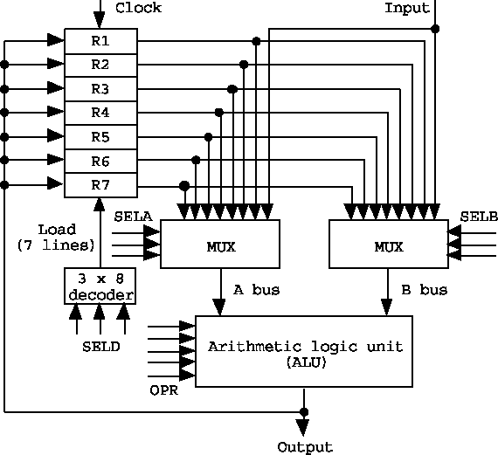

5.2. General Register Organization
a) Block Diagram
b) Control Word
10

Slide 11
5.2. General Register Organization
The control unit that operates the CPU bus system directs the information flow through the registers and ALU by selecting the various components in the system
For example, to perform the operation
R1 ← R2 + R3
The control unit must provide binary selection variables to the following selector inputs:
Binary selector input
MUX A selector (SELA) : to place the content of R2 into BUS A
MUX B selector (SELB) : to place the content of R3 into BUS B
ALU operation selector (OPR) : to provide the arithmetic addition
R2 + R3
Decoder selector (SELD) : to transfer the content of the output bus into R1
11

Slide 12
Encoding of Register Selection Fields:
»SELA or SELB = 000 (External Input) : MUX selects the external data
»SELD = 000 (None) : no destination register is selected but the contents of the output bus are available in the external output

Slide 13
5.2. General Register Organization
Example:
Micro-operation: R1 Control word Field: SELA | ← R2 SELB | + | R3 SELD | OPR
Symbol: R2 | R3 |  | R1 | Add
Control word:010 | 011 |  | 001 | 00010
Q: let the content of R2=0001 and R3=0010, Please specify which register is selected by the decoder and what is the value going to be stored in the target register using the above given instruction in the control word.
Ans: R1, 0011

Slide 14
5.3 Stack Organization
A useful feature that is included in the CPU of most computers is a stack or last-in, first-out(LIFO) list
Stack: A storage device that stores information in such a manner that the item stored last is the first item retrieved.
The operation of a stack can be compared to a stack of trays. The last tray placed on top of the stack is the first to be taken off.

Slide 15
5.3 Stack Organization
Stack pointer (SP): A register that holds the address of the top item in the stack.
SP always points at the top item in the stack
There are exactly two operations that can be performed on a stack.
Push (Push-down): it is the result of pushing a new item on top
Operation to insert an item into the stack.
It adds a new item to the top of the stack
Pop (Pop-up): it is the result of removing an item from the top
Operation to retrieve an item from the stack.
It removes an item from the top of the stack.

Slide 16
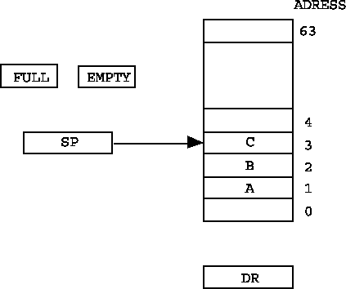
Register Stack
A stack can be organized as a collection of a finite number of registers.
In a 64-word stack, the stack pointer contains 6 bits.
The one-bit register
FULL is set to 1 when the stack is full;
EMPTY register is 1 when the
stack is empty.
The data register DR holds the data to be written into or
read from the stack.

Slide 17
The following are the micro-operations associated with the stack
Three items are placed in the stack: A,B, and C in that order
The push operation is implemented with the following sequence of microoperation.
SP ← 0, EMPTY ← 1, FULL ← 0 (Initialization)
SP ← SP + 1
(increment the pointer )
M[SP] ← DR
( Write item on top of the stack )
If(SP = 0)then(FULL ← 1)
(Check if the stack is full)
EMPTY ← 0
( mark the stack not empty)
Note that SP becomes 0 after 63

Slide 18
The following are the micro-operations associated with the stack
A new item is deleted from the stack if the stack is not empty.
The pop operation consists of the following sequence of micro-operations.
DR ← M[SP]
(Read item from the top of stack)
SP ← SP – 1
(decrement the stack pointer)
If(SP=0)then EMPTY ← 1)( check if the stack is empty)
FULL ← 0 ( mark the stack not full)

Slide 19
Reverse Polish Notation (RPN)
A stack organization is very effective for evaluating arithmetic expressions
The common mathematical method of writing arithmetic expressions imposes difficulties when evaluated by a computer
The common arithmetic expressions are written in infix notation, with each operator written between the operands.
Reverse polish notation : is a postfix notation (places operators after operands)
Example : Consider the following expression:
A + B Infix notation
• +AB Prefix or polish notation
AB+ Postfix or Reverse Polish notation

Slide 20
Reverse Polish Notation (RPN)
The reverse Polish notation is in a form suitable for stack manipulation.
The following expressions are written in reverse polish notation
as:
A * B + C * D → (AB *)+(CD *) → AB * CD * +
( 3 * 4 ) + ( 5 * 6 ) → 34 * 56 * +
Evaluation procedure:
Scan the expression from left to right.
When an operator is reached, perform the operation with the two operands found on the left side of the operator.
Replace the two operands and the operator by the result obtained from the operation.

Slide 21
Reverse Polish Notation (RPN)
Example: consider the following expression
Infix (3 * 4) + (5 * 6) = 42
Reverse polish notation: 3 4 * 5 6 * +
stack evaluation:
Get value
If value is data: push data
Else if value is operation: pop, pop evaluate and push.
12 5 6 * +
12 30 +
42

Slide 22
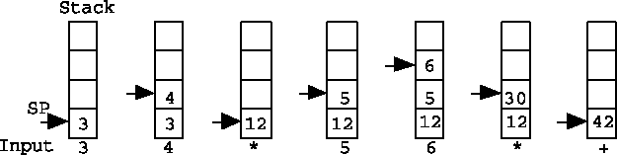
Reverse Polish Notation (RPN)
Reverse polish notation : 3 4 * 5 6 * +
Consider the stack operation below:
First the number 3 is pushed to the stack then the number 4
The next symbol is the multiplication operator *
This causes a multiplication of the two topmost items in the stack
The stack is then popped and the product is placed on top of the stack,
replacing the two original operands.

Slide 23
5.4 Complex Instruction Set Computers: CISC
A computer with large number of instructions is called
complex instruction set computer or CISC.
Complex instruction set computer is mostly used in scientific computing applications requiring lots of floating point arithmetic.
It is designed to minimize the number of instruction per program ang ignoring the number of cycles per instruction.
Mostly used in desktop or laptop computers.
Short Length of code. Hence very little RAM required to store instruction.

Slide 24
CISC Characteristics
A large number of instructions - typically from 100 to 250 instructions.
Some instructions that perform specialized tasks and are used infrequently.
A large variety of addressing modes - typically 5 to 20 different modes.
Variable-length of instruction formats.
Several cycles required to execute one instruction.
Instruction decoding logic is complex.
Instructions that manipulate operands in memory.

Slide 25
Reduced Instruction Set Computers: RISC
A computer with few instructions and simple construction is called reduced instruction set computer or RISC.
It is designed to reduce the execution time by simplifying the instruction set computer.
Each instruction requires only one clock cycle to execute the result in uniform execution time.
it reduces the efficiency as there are more lines of codes. Hence, more RAM needed to store the instruction.
It uses highly optimized set of instructions.
It uses in portable devices.
RISC architecture is simple and efficient.

Slide 26
characteristics of RISC :
It consists of relatively few & simple instructions
It supports various data type formats
It utilizes simple addressing modes
It consists of ne cycle execution time
Memory access limited to LOAD and STORE instructions
It consists of large number of register
All operations are done within the registers of the CPU
Fixed-length and easily-decoded instruction format.

Slide 27
CISC and RISC
Emphasis on hardware
Multiple clock cycle
Consists not or less pipelined
Perform on memory to memory
Having variable format instruction
Any instructions may refer memory
Software
Single clock cycle per instruction
Highly pipelined
Register to register
Fixed format instruction
Only LOAD/STORE instruction refers memory

Slide 28
Chapter 6: Memory Organization
Sub topics includes:
Memory Hierarchy
Main Memory
External Memory
Cache Memory
28

Slide 29
6. Memory Organization
The memory unit is an essential component in any digital computer since it is needed for storing programs and data
No one technology is optimal in satisfying the memory requirements for a computer system.
It exhibits widest range of type, technology, organization, performance and cost.
Not all accumulated information is needed by the CPU at the same time
Therefore, it is more economical to use low-cost storage devices to serve as a backup for storing the information that is not currently used by CPU
29

Slide 30
6. Memory Organization
Some characteristics of Memory Systems
Location: Refers to whether it is internal or external to computer
Internal: Directly accessible by CPU
main memory, cache, registers
External: Accessible by CPU through I/O module
magnetic disks, tapes, optical disks
Access method
Sequential access: Access to records is made in a specific linear sequence eg. Magnetic tape
Random access: the storage locations can be accessed in any order. e.g. RAM and ROM
30

Slide 31
6. Memory Organization
Some characteristics of Memory Systems
Performance:
The average time required to reach a storage location in memory and obtain its contents is called the access time
Access time (latency) is the time between "requesting" data and getting it
The access time = seek time + transfer time
Seek time: time required to position the read-write head to a location
Transfer time: time required to transfer data to or
from the device
Transfer rate: rate at which data can be moved into/out of a memory unit
31

Slide 32
6.1 Memory Hierarchy
The design constraints on a computer’s memory can be summed up by three questions:
− How much is the capacity? Storage capacity
− How fast? Speed
− How expensive? Cost
A variety of technologies are used to implement memory systems, and across this spectrum of technologies, the following relationships hold:
− Faster access time, greater cost per bit
− Greater capacity, smaller cost per bit
− Greater capacity, slower access time
32

Slide 33
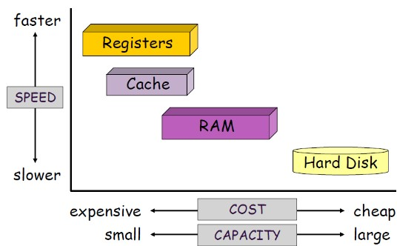
6.1 Memory Hierarchy
The total memory of a computer system is organized as the hierarchy of memories as shown below.
Economic and performance are the basis for the hierarchy for memory organization
33

Slide 34
6.1 Memory Hierarchy
As one goes down the hierarchy, the following occurs:
Cost per bit Decrease (cheaper)
Increasing storage capacity
Increasing access time (slower in speed)
Decreasing frequency of access of the memory by the processor
The memory unit that directly communicate with CPU is called the main memory
Devices that provide backup storage are called auxiliary memory
The memory hierarchy system consists of all storage devices employed in a computer system from the slow by high-capacity auxiliary memory to a relatively faster main memory, to an even smaller and faster cache memory
34

Slide 35
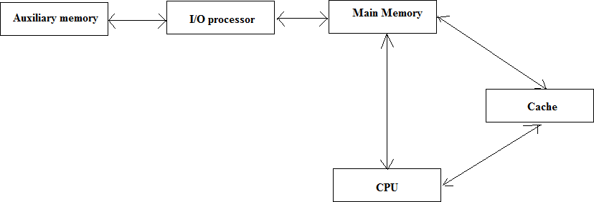
6.1 Memory Hierarchy
The main memory occupies a central position by being able to communicate directly with the CPU and with auxiliary memory devices through an I/O processor
A special very-high-speed memory called cache is used to increase the speed of processing by making current programs and data available to the CPU at a rapid rate
35

Slide 36
6.1 Memory Hierarchy
CPU logic is usually faster than main memory access time, with the result that processing speed is limited primarily by the speed of main memory
The cache is used for storing segments of programs currently being executed in the CPU and temporary data frequently needed in the present calculations
The typical access time ratio between cache and main memory is about 1 to 7
Auxiliary memory access time is usually 1000 times that of main memory
36

Slide 37
6.2 Main Memory
The memory unit that communicates directly with CPU is called main memory/Primary memory.
It stores data and program during computer operations.
It uses semiconductor technology hence known as semiconductor memory.
Most of the main memory in a general purpose computer is made up of RAM integrated circuits chips, but a portion of the memory may be constructed with ROM chips
RAM– Random Access memory or read/write memory
Integrated RAM are available in two possible operating modes, Static and Dynamic
ROM– Read Only memory
37

Slide 38
6.2 Main Memory
Random-Access Memory (RAM)
Static RAM (SRAM)
Each cell stores bit with a six-transistor circuit.
Retains value indefinitely, as long as it is kept powered.
Relatively insensitive to disturbances such as electrical noise.
Faster and more expensive than DRAM and used for cache
memory
Dynamic RAM (DRAM)
Each cell stores bit with a capacitor and transistor.
Loses its stored information in a very short time (a few
milliseconds) even though the power supply is on
Value must be refreshed every 10-100 ms.
Sensitive to disturbances.
Slower and cheaper than SRAM and used for main memory
38

Slide 39
6.2 Main Memory
Read Only Memory (ROM)
ROM is used for storing programs that are PERMENTLY
resident in the computer
The ROM portion of main memory is needed for storing an initial program called a bootstrap loader.
The bootstrap loader((BIOS) is a program whose function is to start the computer software operating when power is turned on.
Nonvolatile memory: The contents of ROM remain unchanged after power is turned off.
39

Slide 40
6.3 Auxiliary Memory/External Memory
Storage devices that provide backup storage are called
auxiliary/external memory/secondary memory.
Used to store programs and data which are not needed immediately by the CPU, large data files, backup data
Not urgently needed data are stored here.
It is non volatile
Common used secondary memory includes:
Magnetic disks,
Optical disks,
Magnetic tapes, etc.
40

Slide 41
6.4 Cache memory
A cache memory is
a small capacity memory ,
very nearest memory to the CPU, all the recent instruction are stored in it
very fast memory that retains copies of recently used information from main memory.
Is attached for storing the input which is given by the user & which is necessary for the CPU to perform a task.
41

Slide 42
6.4 Cache memory
Is a reserved section of main memory (RAM) that is used to enhance performance of a CPU.
If the active portions of the program and data are placed in a fast small memory, the average memory access time can be reduced,
Thus reducing the total execution time of the program
The cache is one of the fastest component in the memory hierarchy and approaches the speed of CPU component

Slide 43
6.4 Cache memory
If the processor finds the address code data is not available in cache is referred as CACHE MISS.
If the processor finds the address code data is available in cache is referred as SUCCESS.

Slide 44
6.4 Cache memory
It is located between the main memory and the CPU
When CPU needs to access memory, the cache is examined
If the word is found in the cache, it is read from the fast memory (cache memory)
If the word addressed by the CPU is not found in the cache, the main memory is accessed to read the word
The basic characteristic of cache memory is its fast access time
44

Slide 45
Thank you!!!! End of class

